Slide 1
Commencement Skillset
A Review for the S3O Service Line

Slide 2
What is Commencement?
Definition
Difference between Graduation and Commencement
What is convocation?
Commencement Website
Notes:
A commencement ceremony is a formal program to honor and celebrate the academic achievement of graduates. Each ceremony features a keynote address, graduate speakers, and the conferral of degrees (individual recognition of participating graduates).
Graduation: The university process by which WGU verifies academic and financial requirements for program completion and confers a graduation date. (Process)
Commencement: The celebration of our graduate's accomplishments and public recognition of degrees obtained. (Party)
Each are handled by different teams.
The convocation ceremony is where each graduate will have their moment in the spotlight and walk across the stage to be recognized individually. We typically utilize this model when we are expecting a high volume of graduates- in which those ceremonies can go past 3 hours.
Walk through the commencement website showing each resource.

Slide 3
Virtual vs In-Person Ceremonies
What is a virtual ceremony?
What is an in-person ceremony?
What are the differences between the two?
Notes:
Virtual Commencement is a ceremony that is held entirely online.
In-Person ceremonies are live in-person commencements and convocations.
Virtual: Students record videos to be played during the ceremony. Diplomas are mailed to the participants.
In-Person: Students physically walk across the stage to receive their diploma cover. Diplomas are still mailed to the students.

Slide 4
Eligibility
What are the requirements to participate?
What is the exception to the final course rule?
Notes:
Students or graduates who wish to participate in an in-person or virtual commencement ceremony must have either their Graduation Application submitted to the Student Records department or be enrolled in and only have their final course left, such as capstone or final certification, with the exception of direct hours for field experience or student teaching.

Slide 5
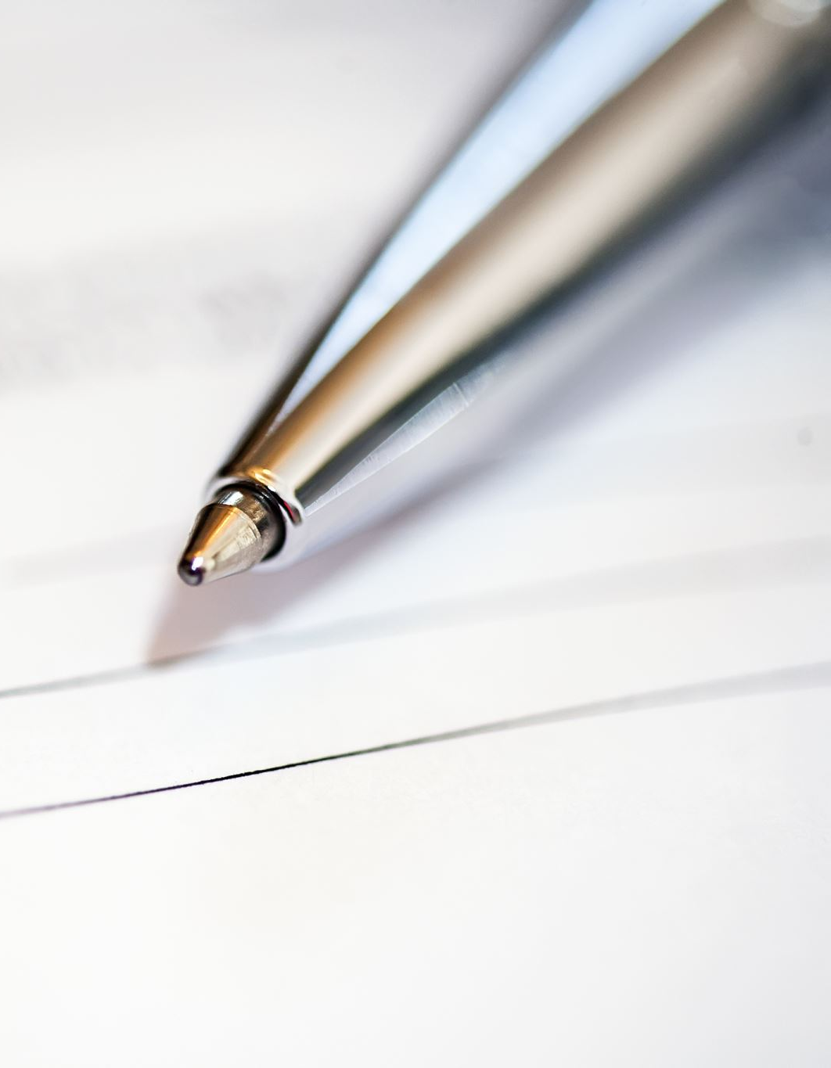
How to Register
Ceremony Exception Request (Final Course)
How can a student request this?
What if the student is on the phone?
Case Example
RSVP Browser Error
Chrome or Firefox Only
Notes:
This is an accommodation for our students who are very close to graduation but the Commencement they want to participate in is happening before they complete their final course
If the student only has one course left and would like to participate in commencement, they will need to have their eligibility verified by submitting an email to commencement@wgu.edu with "Final Course" in the subject line.
If the student is on the phone and needs immediate assistance with their ceremony exception request, you can process that request immediately.
Pull final course case and work it with the participants.
RSVP form will not work with Safari or other browsers than that listed.

Slide 6
Regalia
What is Regalia?
Where to Buy
Deadlines for Purchase
Day-Of Purchase
Purchasing from Other Students
Notes:
Regalia is the "uniform" for commencement. It can include cap, gown, tassels, honor cords, philanthropy cords, etc.
Regalia used to be purchased from Oak Hall, however WGU is in the process of changing vendors. It is recommended that students wait until after 1/1/25 to order from the yet unnamed new vendor.
Must be purchased at least 4 weeks prior to ceremony.
If a graduate misses the cap & gown deadline, they can purchase regalia on-site. The vendor will bring a limited supply of regalia to the event and has a table for on-site regalia purchase at Grad check-in.
Graduates can also search WGU Facebook groups or the Commencement App Celebration Wall and inquire if anyone would be interested in selling/donating their regalia.

Slide 7
Week of Commencement Issues
Grad Pass
What is it?
Where do they receive their grad pass?
Multiple Degrees
Parking/Venue Information
Notes:
Grad passes are electronic passes that include a QR code that contains the student’s name and their degree. The students Grad Pass is emailed the week of commencement to the email address that the student entered on their RSVP. Note: It is not always their WGU email.
Show how to add multiple degrees to the reservation.
Parking/Venue information is available on the app.

Slide 8
Photos and Stage Clips
The Grad Team Website
Stage Clip Site
Notes:
Search for Erika Bruner during the Indianapolis 2022 Commencement

Slide 9
Guest Visa Requests
Students need an invitation letter to obtain travel visas for guests.
Email Records request with “Commencement Invitation Letter Request” in subject line.
Include:
Name
Relation to student
Commencement Ceremony the student wishes to participate in.
Foreign Mailing Address.

Slide 10
Diploma Covers
Students are issued one diploma cover per ceremony.
If the student does not attend a ceremony, they can purchase one from the WGU Store.
Replacement Requests
Diploma cover received at an in-person commencement was damaged.
Diploma cover received for a virtual commencement was damaged.
Previously attended a commencement and did not receive one.
Please escalate the case number to the Commencement Team via Teams.

Slide 11
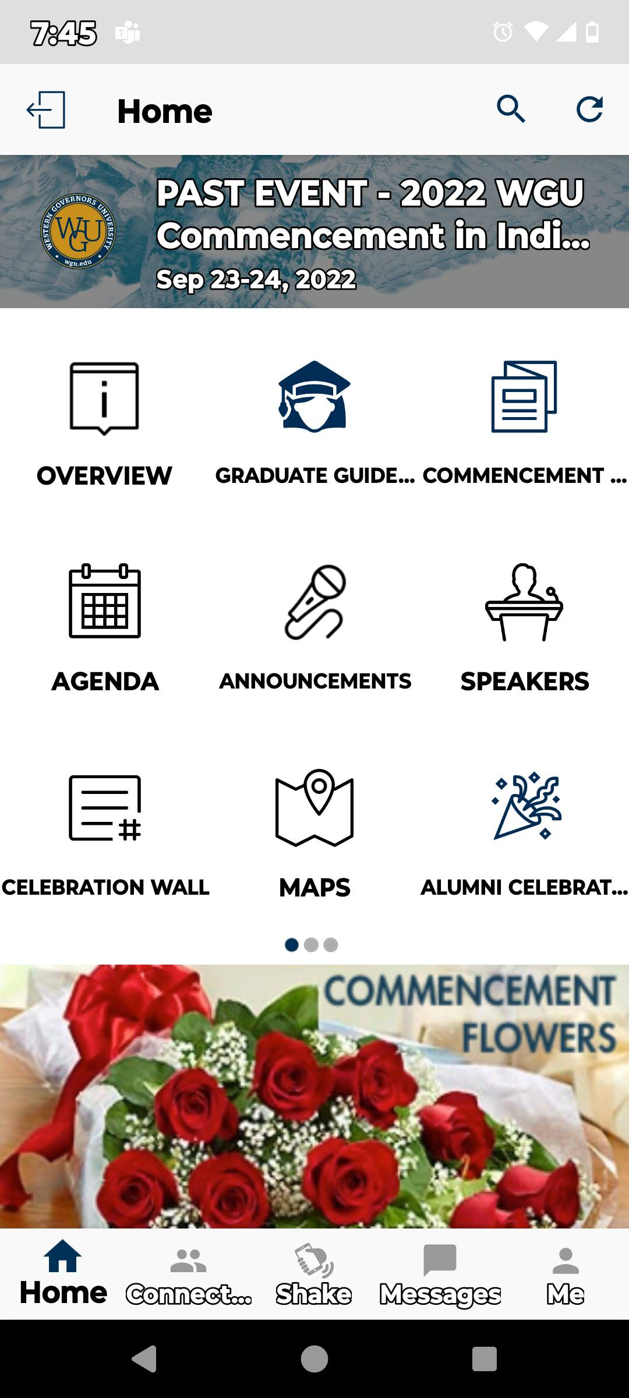
Commencement App
Contains useful information the student will need to know regarding their commencement ceremony, including:
Commencement Overview
Graduate Guide
Commencement News
Commencement Agenda
Announcements
Speakers List
Celebration Wall
Maps
Alumni Celebration Information
Alumni Chat
And Much, Much More!
Notes:
If students have questions regarding any of the above or how to stay in-the-know regarding their celebration, it is permissible to give them directions on downloading the app from the Apple Store or Google Play Store.

Slide 12
Escalations
Notes:
Tag channel when posting.
Use KB and other resources prior to using escalation chat.

Slide 13
Case Management
Let’s work some cases!
Queue: S3O Commencement Customer Service
Notes:
Work 1-2 cases while specialists observe. Work 2-3 cases while trainer observes.

